Slide 1
Digital Portfolio
STUDENT NAME: AYSHA MALHAN.M.B
REGISTER NO AND NMID: 31224U09015
DEPARTMENT: BACHELOR OF COMPUTER APPLICATION
COLLEGE: COLLEGE/ UNIVERSITY
ISLAMIAH WOMEN 'S ARTS AND SCIENCE COLLEGE

Slide 2
PROJECT TITLE
Creative & Visual portfolio

Slide 3


AGENDA
Problem Statement
Project Overview
End Users
Tools and Technologies
Portfolio design and Layout
Features and Functionality
Results and Screenshots
Conclusion
Github Link
3/21/2024 Annual Review

Slide 4

PROBLEM STATEMENT
Recruiters/clients struggle to quickly judge fit from scattered links.
Need a single destination that tells your story, shows work, and makes contacting you effortless—on mobile first.
Constraints: fast load, accessible markup, minimal JS, SEO-friendly.
MDN Web Docs

Slide 5

PROJECT OVERVIEW
Build a fast, responsive personal portfolio to showcase projects, skills, and contact info.
Tech: HTML (structure), CSS (presentation), JavaScript (interactivity).
MDN Web Docs
+1
Success = clear content hierarchy + great UX + strong performance (Core Web Vitals).

Slide 6

WHO ARE THE END USERS?
Recruiters/Clients: scan fast; want role, skills, 2–4 best projects, contact.
Peers/Collaborators: explore code, stack, and live demos.
General audience: simple bio, social links.
Keep layout scannable; don’t let flashy effects block info.
Reddit

Slide 7

TOOLS AND TECHNIQUES
Recruiters/Clients: scan fast; want role, skills, 2–4 best projects, contact.
Peers/Collaborators: explore code, stack, and live demos.
General audience: simple bio, social links.
Keep layout scannable; don’t let flashy effects block info.
Reddit

Slide 8
POTFOLIO DESIGN AND LAYOUT
Simple IA: Home (hero) → Projects → About → Contact.
Visual hierarchy: big name/title, concise tagline, primary CTA.
Grid thumbnails with short case-study blurbs; deep pages optional.
Ensure mobile-first spacing/typography; clear nav.
Nielsen Norman Group
8

Slide 9
FEATURES AND FUNCTIONALITY
Hero with headline + CTA; filterable projects; light/dark toggle (optional).
Accessible modals/cards; keyboard nav; alt text.
Fast: preconnect fonts, compress images, defer non-critical JS.

Slide 10
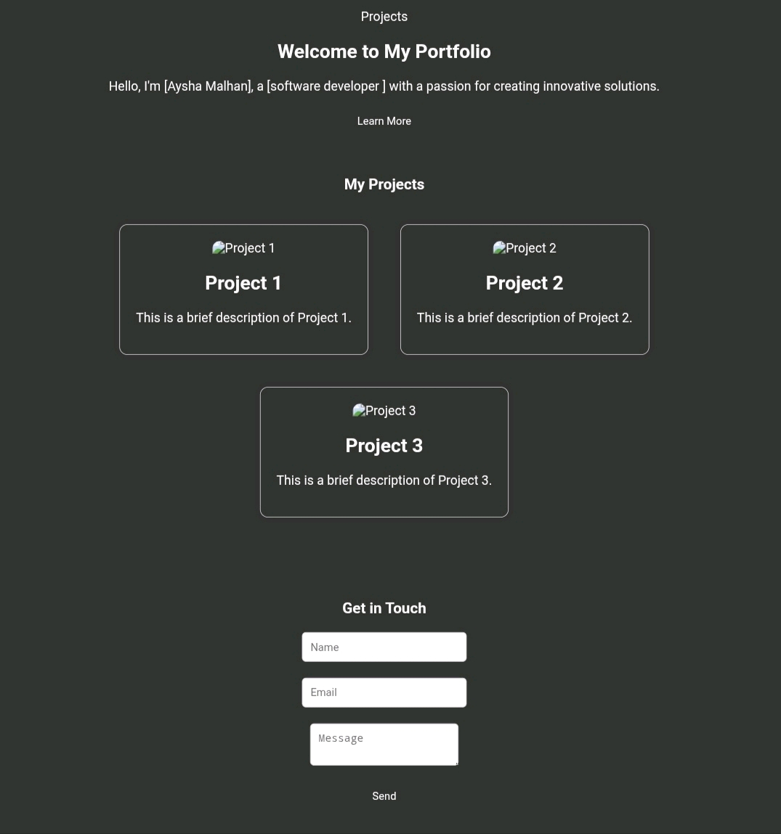

RESULTS AND SCREENSHOTS
3/21/2024 Annual Review
10

Slide 11
CONCLUSION
A focused, fast portfolio improves discoverability and conversion (contact/hire).
Ship MVP, measure Core Web Vitals, iterate on real feedback
11

